Slide 1
Week - 3
Presented by:
Shafin Bin Hamid
Lecturer
Department of Electrical and Electronics Engineering
Bangladesh University of Engineering and Technology

Slide 2
Outline
Supernode and Supermesh
Linearity property
Superposition theorem
Source transformation
Thevenin theorem
Norton theorem
Maximum power transfer theorem

Slide 3
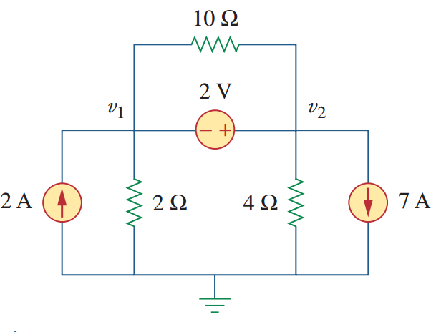
Supernode

Slide 4
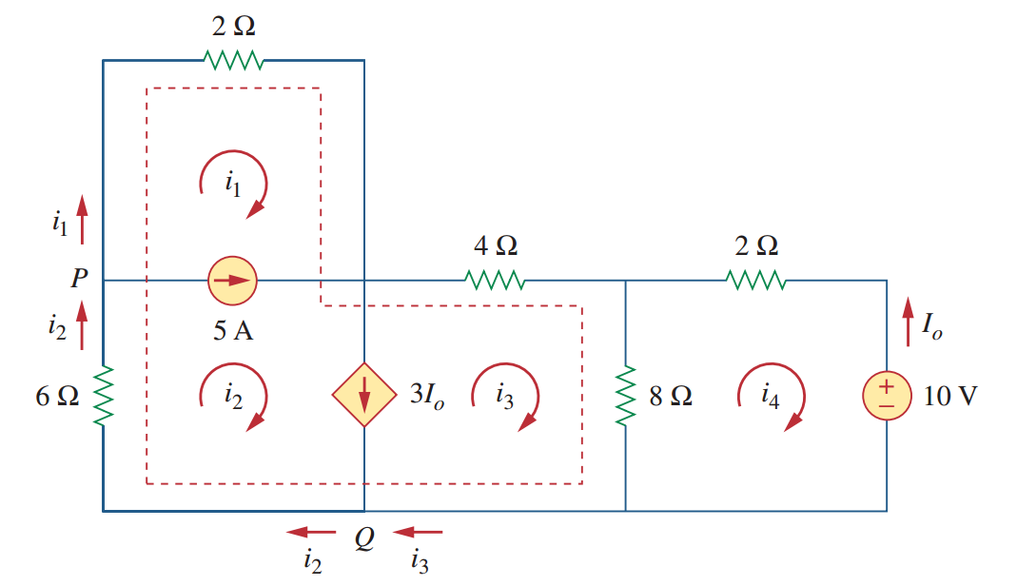
Supermesh

Slide 5

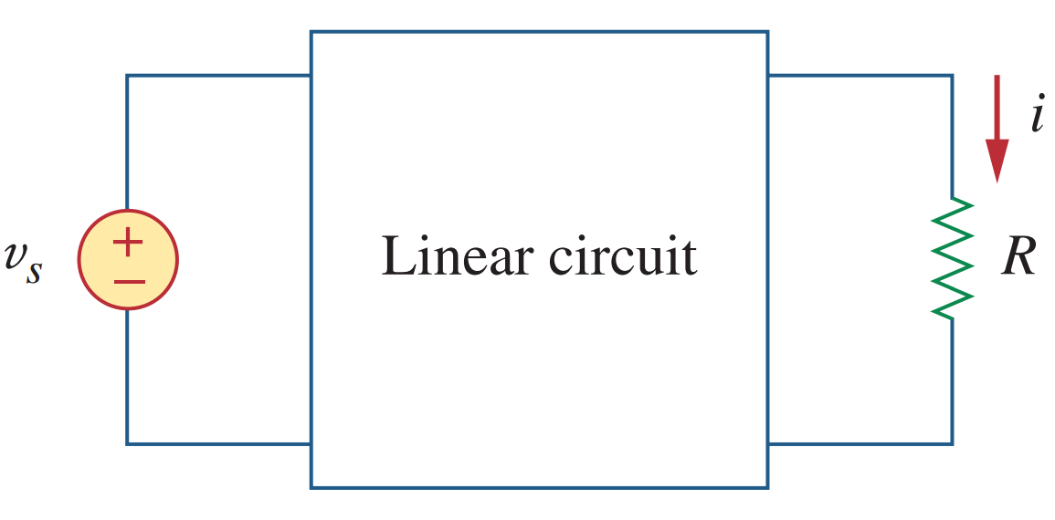
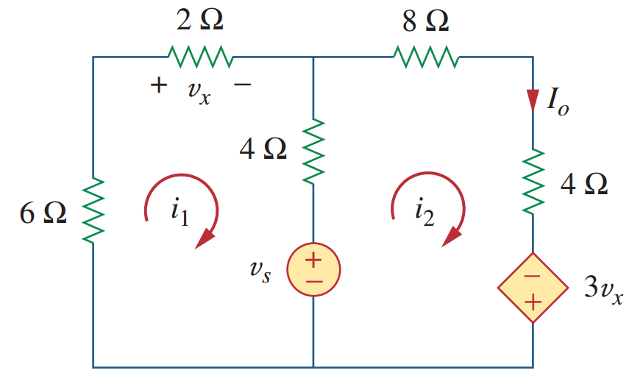
Linearity property

Slide 6

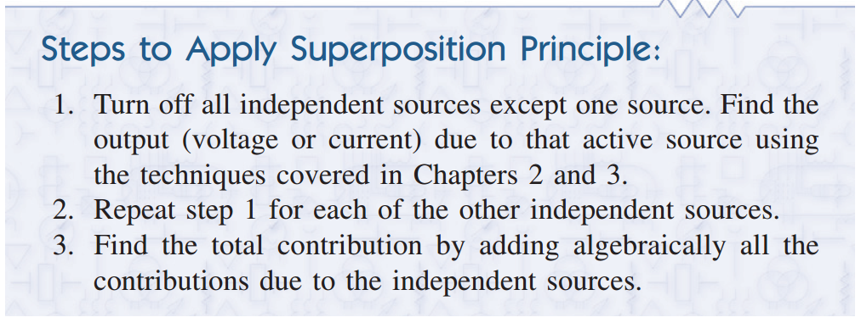
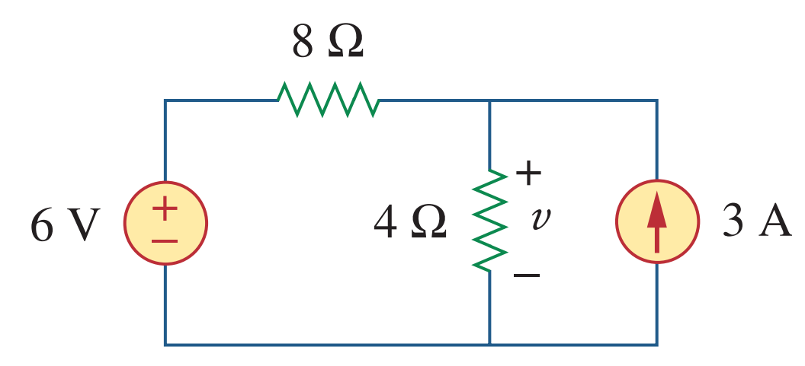
Superposition theorem

Slide 7
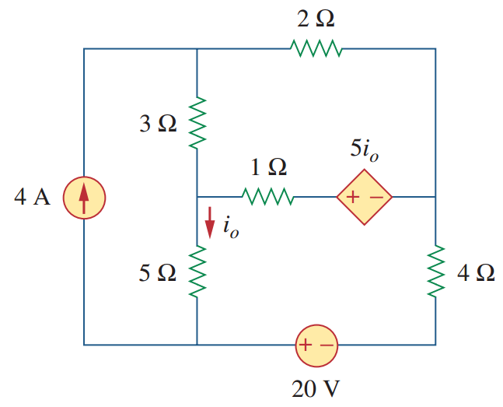
Problems

Slide 8


Source transformation
Source transformation also applies to dependent sources.

Slide 9
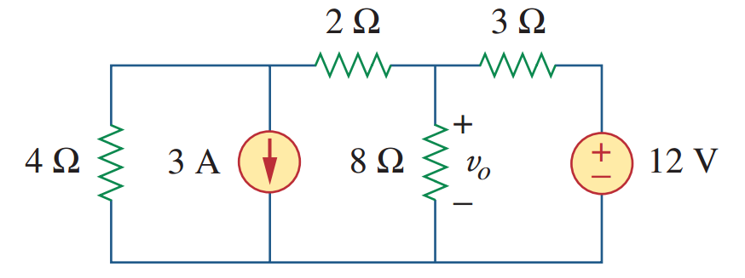
Problems

Slide 10
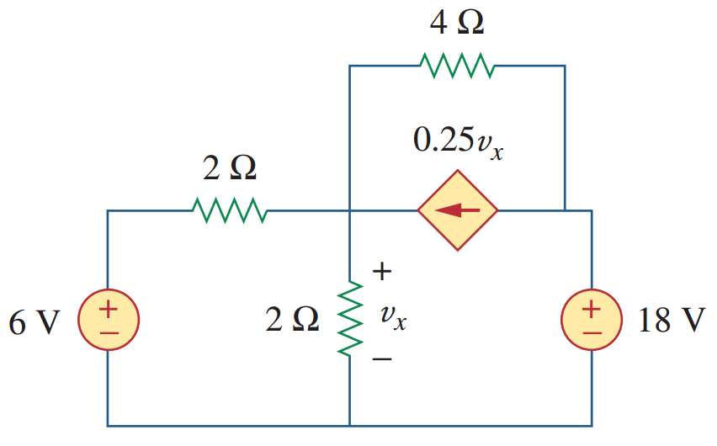
Problems

Slide 11

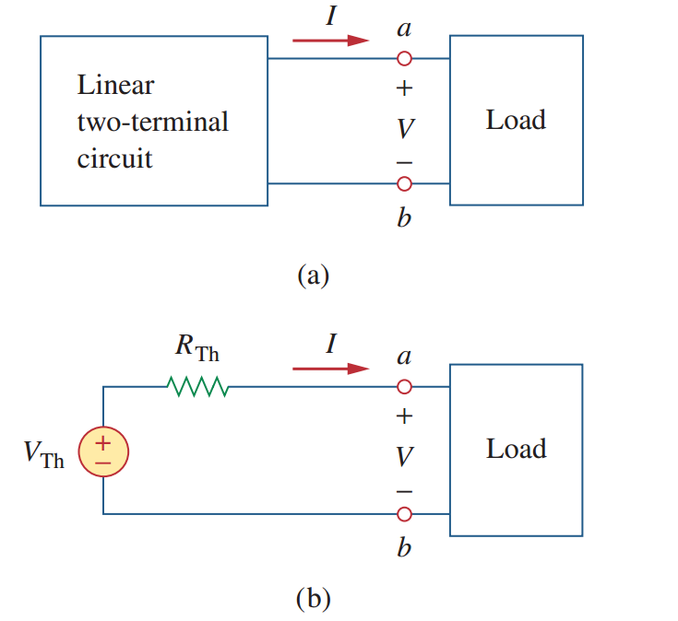
Thevenin’s theorem

Slide 12

Thevenin’s theorem: V_{th} and R_{th}
Finding V_{th} is very simple. Just find the open circuit voltage at terminals a-b and that is equal to V_{th}.

Slide 13
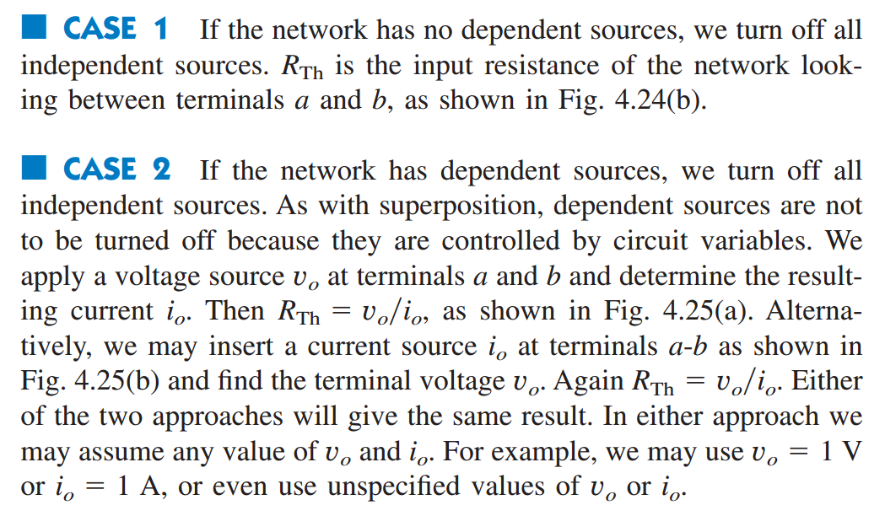
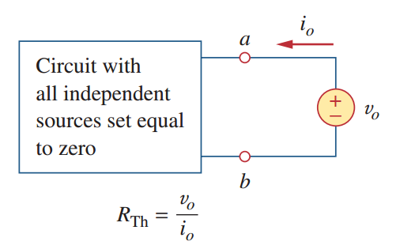
Thevenin’s theorem: Finding R_{th}

Slide 14
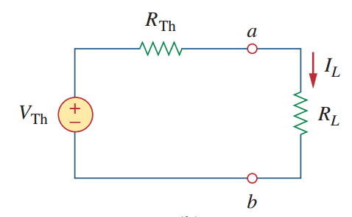
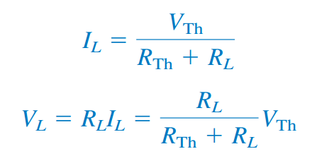
Thevenin’s theorem

Slide 15

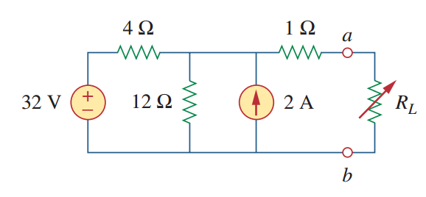
Problems

Slide 16
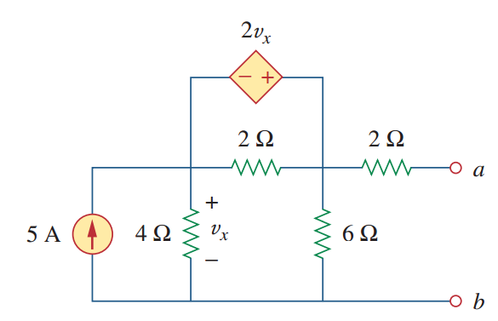
Problems

Slide 17

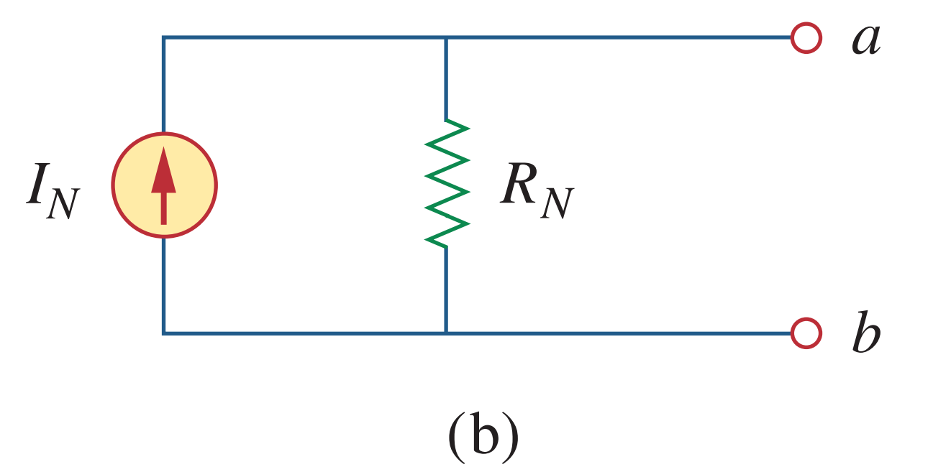
Norton’s theorem

Slide 18
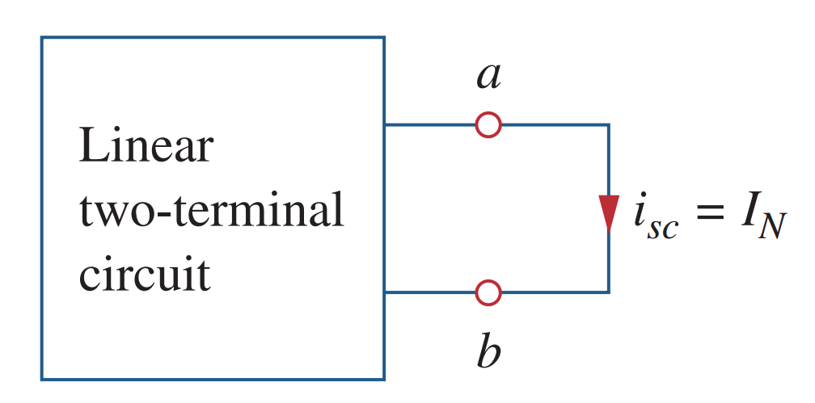
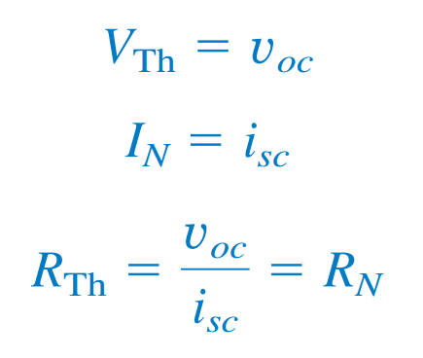
Norton’s theorem: Finding I_{N} and R_{N}

Slide 19
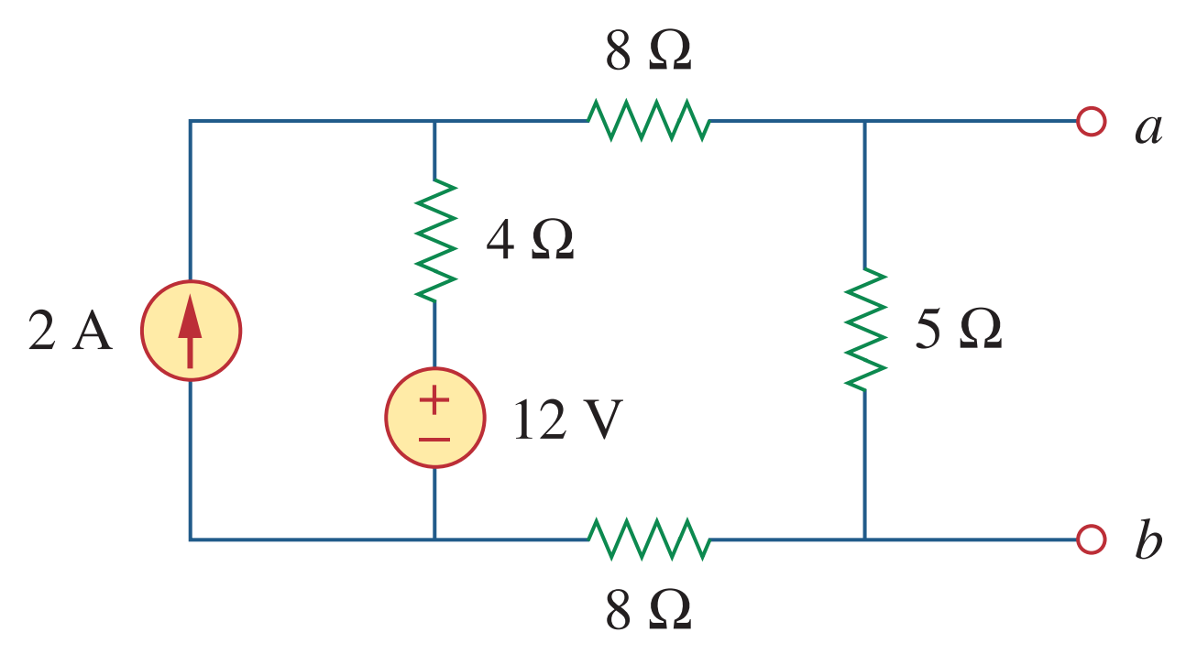
Problems

Slide 20

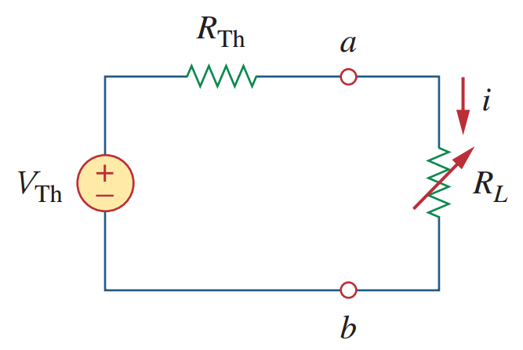
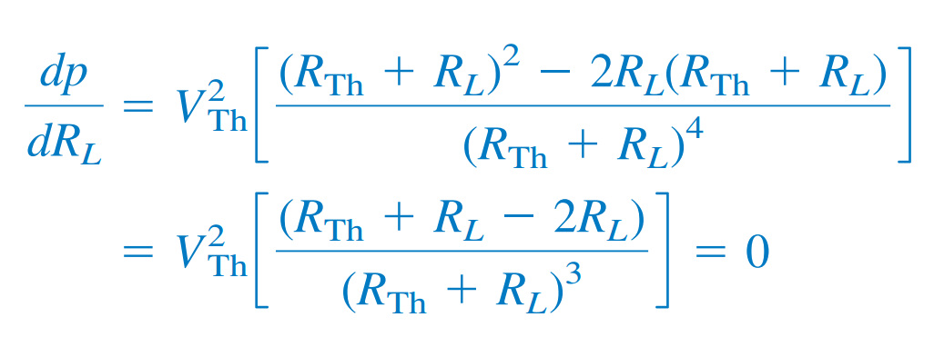
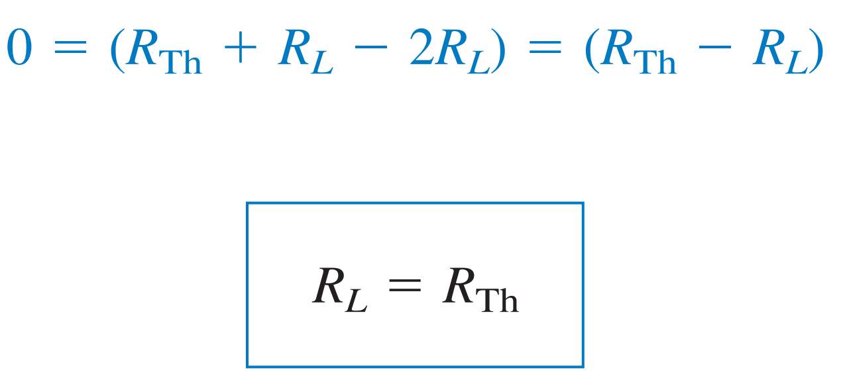
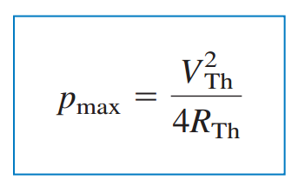

Maximum power transfer theorem

Slide 21
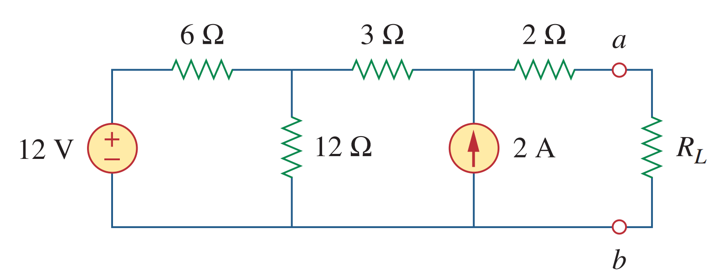
Problems

Slide 22


